Slide 1
PPS MINI-PROJECT
Name :- Yash mankar
Reg.no. :- Ra2111004010254

Slide 2
C PROGRAMMING
C is a procedural programming language. It was initially developed by Dennis Ritchie in the year 1972.
It was mainly developed as a system programming language to write an operating system. The main features of the C language include low-level memory access, a simple set of keywords, and a clean style.
These features make C language suitable for system programmings like an operating system or compiler development.

Slide 3
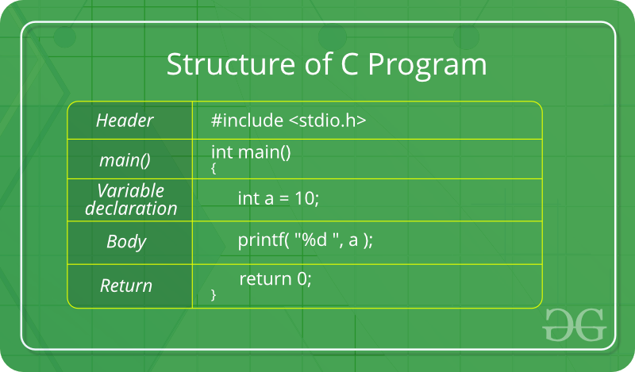
STUCTURE OF C PROGRAMMING

Slide 4
MINI-PROJECT IN C PROGRAMMING
Topic :- Telecom Bill Calculator.
Brief Explanation about my topic :-
Telecom bill calculator is the calculation of money we spend per minute when dialled.
It gives us information about our money used in month from our monthly recharge.
With this mini project in C Telecom Billing System, you can perform and manage billing operations like they do in Telecom companies. Here, you can add records with name, phone number and the amount of payment. You can view, modify, search and delete existing records.

Slide 5
Features of Telecom Billing System in C:
The functions and features used in this project are listed below:
Add new records: add new data into file with name, phone number and amount to be paid
View list of records – lists all telephone billing records (as shown in screenshot 3)
Modify records – edit the added records; name, phone number and/or amount of payment can be edited
View payment – shows amount to be paid
Search records – search for added/updated records in file
Delete records – removes data permanently from file

Slide 6
FLOWCHART
n
START
int talktime;
Talktime=talktime-200
float bill;
printf(“Enter number of talktime”);
scanf(“%d”,&talktime);
Bill=200+(0.6*50)+(0.5*50)+(0.40*talktime)
No
Yes
talktime<=100
Talktime>100&&talktime<=150
Printf(“Your bill is Rs : %0.2f”,bill)
Bill=200
Talktime>
150++
No
Bill=200+(0.6*talktime)
Yes
END

Slide 7
CODE TO BUILD TELECOM BILLING SYSTEM BY C LANGUAGE
#include <stdio.h>
int main()
{ int talktime;
float bill;
printf("Enter number of talktime :");
scanf("%d", &talktime);
if (talktime <= 100) { bill = 200;
}
else if (talktime > 100 && talktime<= 150)
{
talktime = talktime - 100;
bill = 200+(0.60 *talktime);
}
else if (talktime> 150 && talktime<= 200)
{
talktime = talktime - 150; bill = 200+(0.60 *50) + (0.50 *talktime);
}
else
{
talktime = talktime - 200;
bill = 200 + (0.60 * 50) + (0.50 * 50) + (0.40 * talktime);
}
printf("Your bill is Rs. %0.2f", bill);
return 0;
}

Slide 8
THANK YOU

